Slide 1
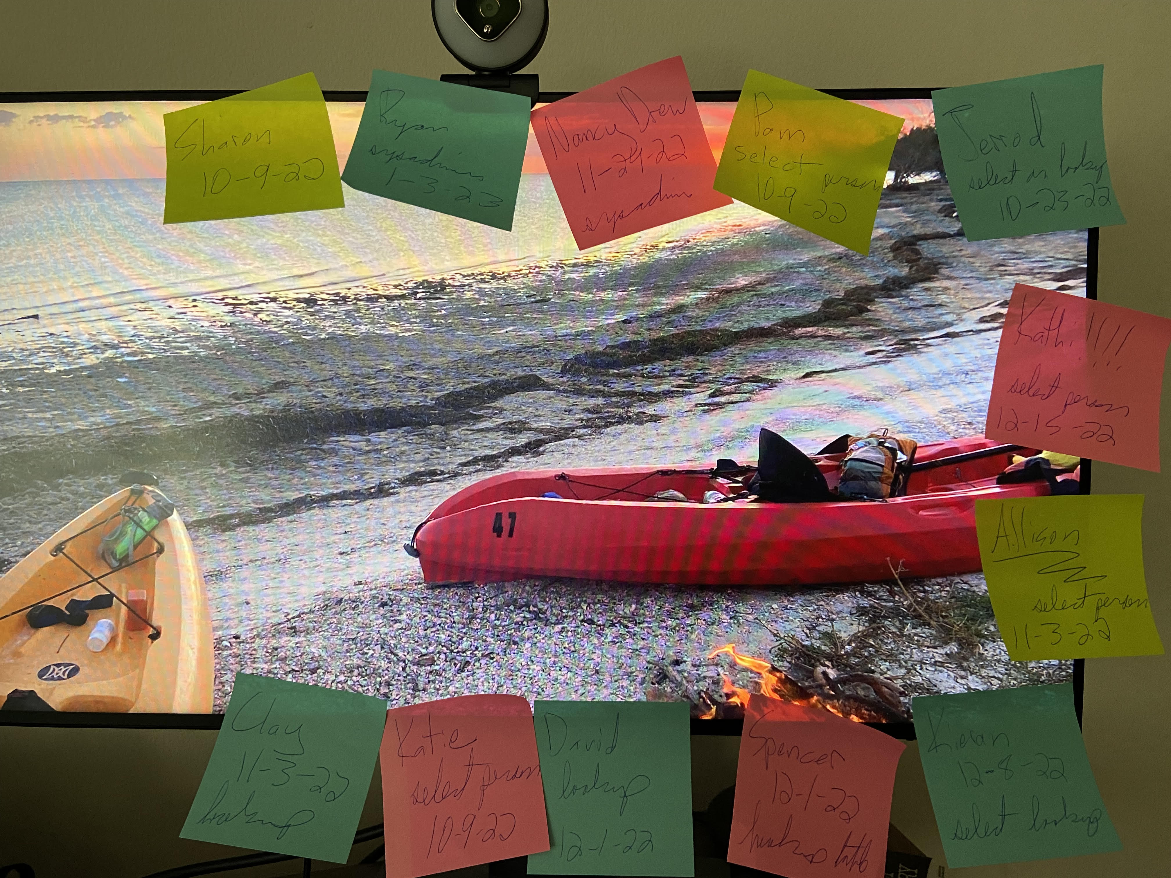
Ditching the Post-Its: Automating Temporary Database Permissions
Sharon Reid
sharon.reid.harris@gmail.com
https://github.com/InfoJunkie1/TempPerms
St. Louis SQL Server and Business Intelligence User Group
Oct. 11, 2022

Slide 2

Extra work!
Enter data in table after granting the perms
Forward expiration email
Delete the perms

Slide 3

Demo

Slide 4
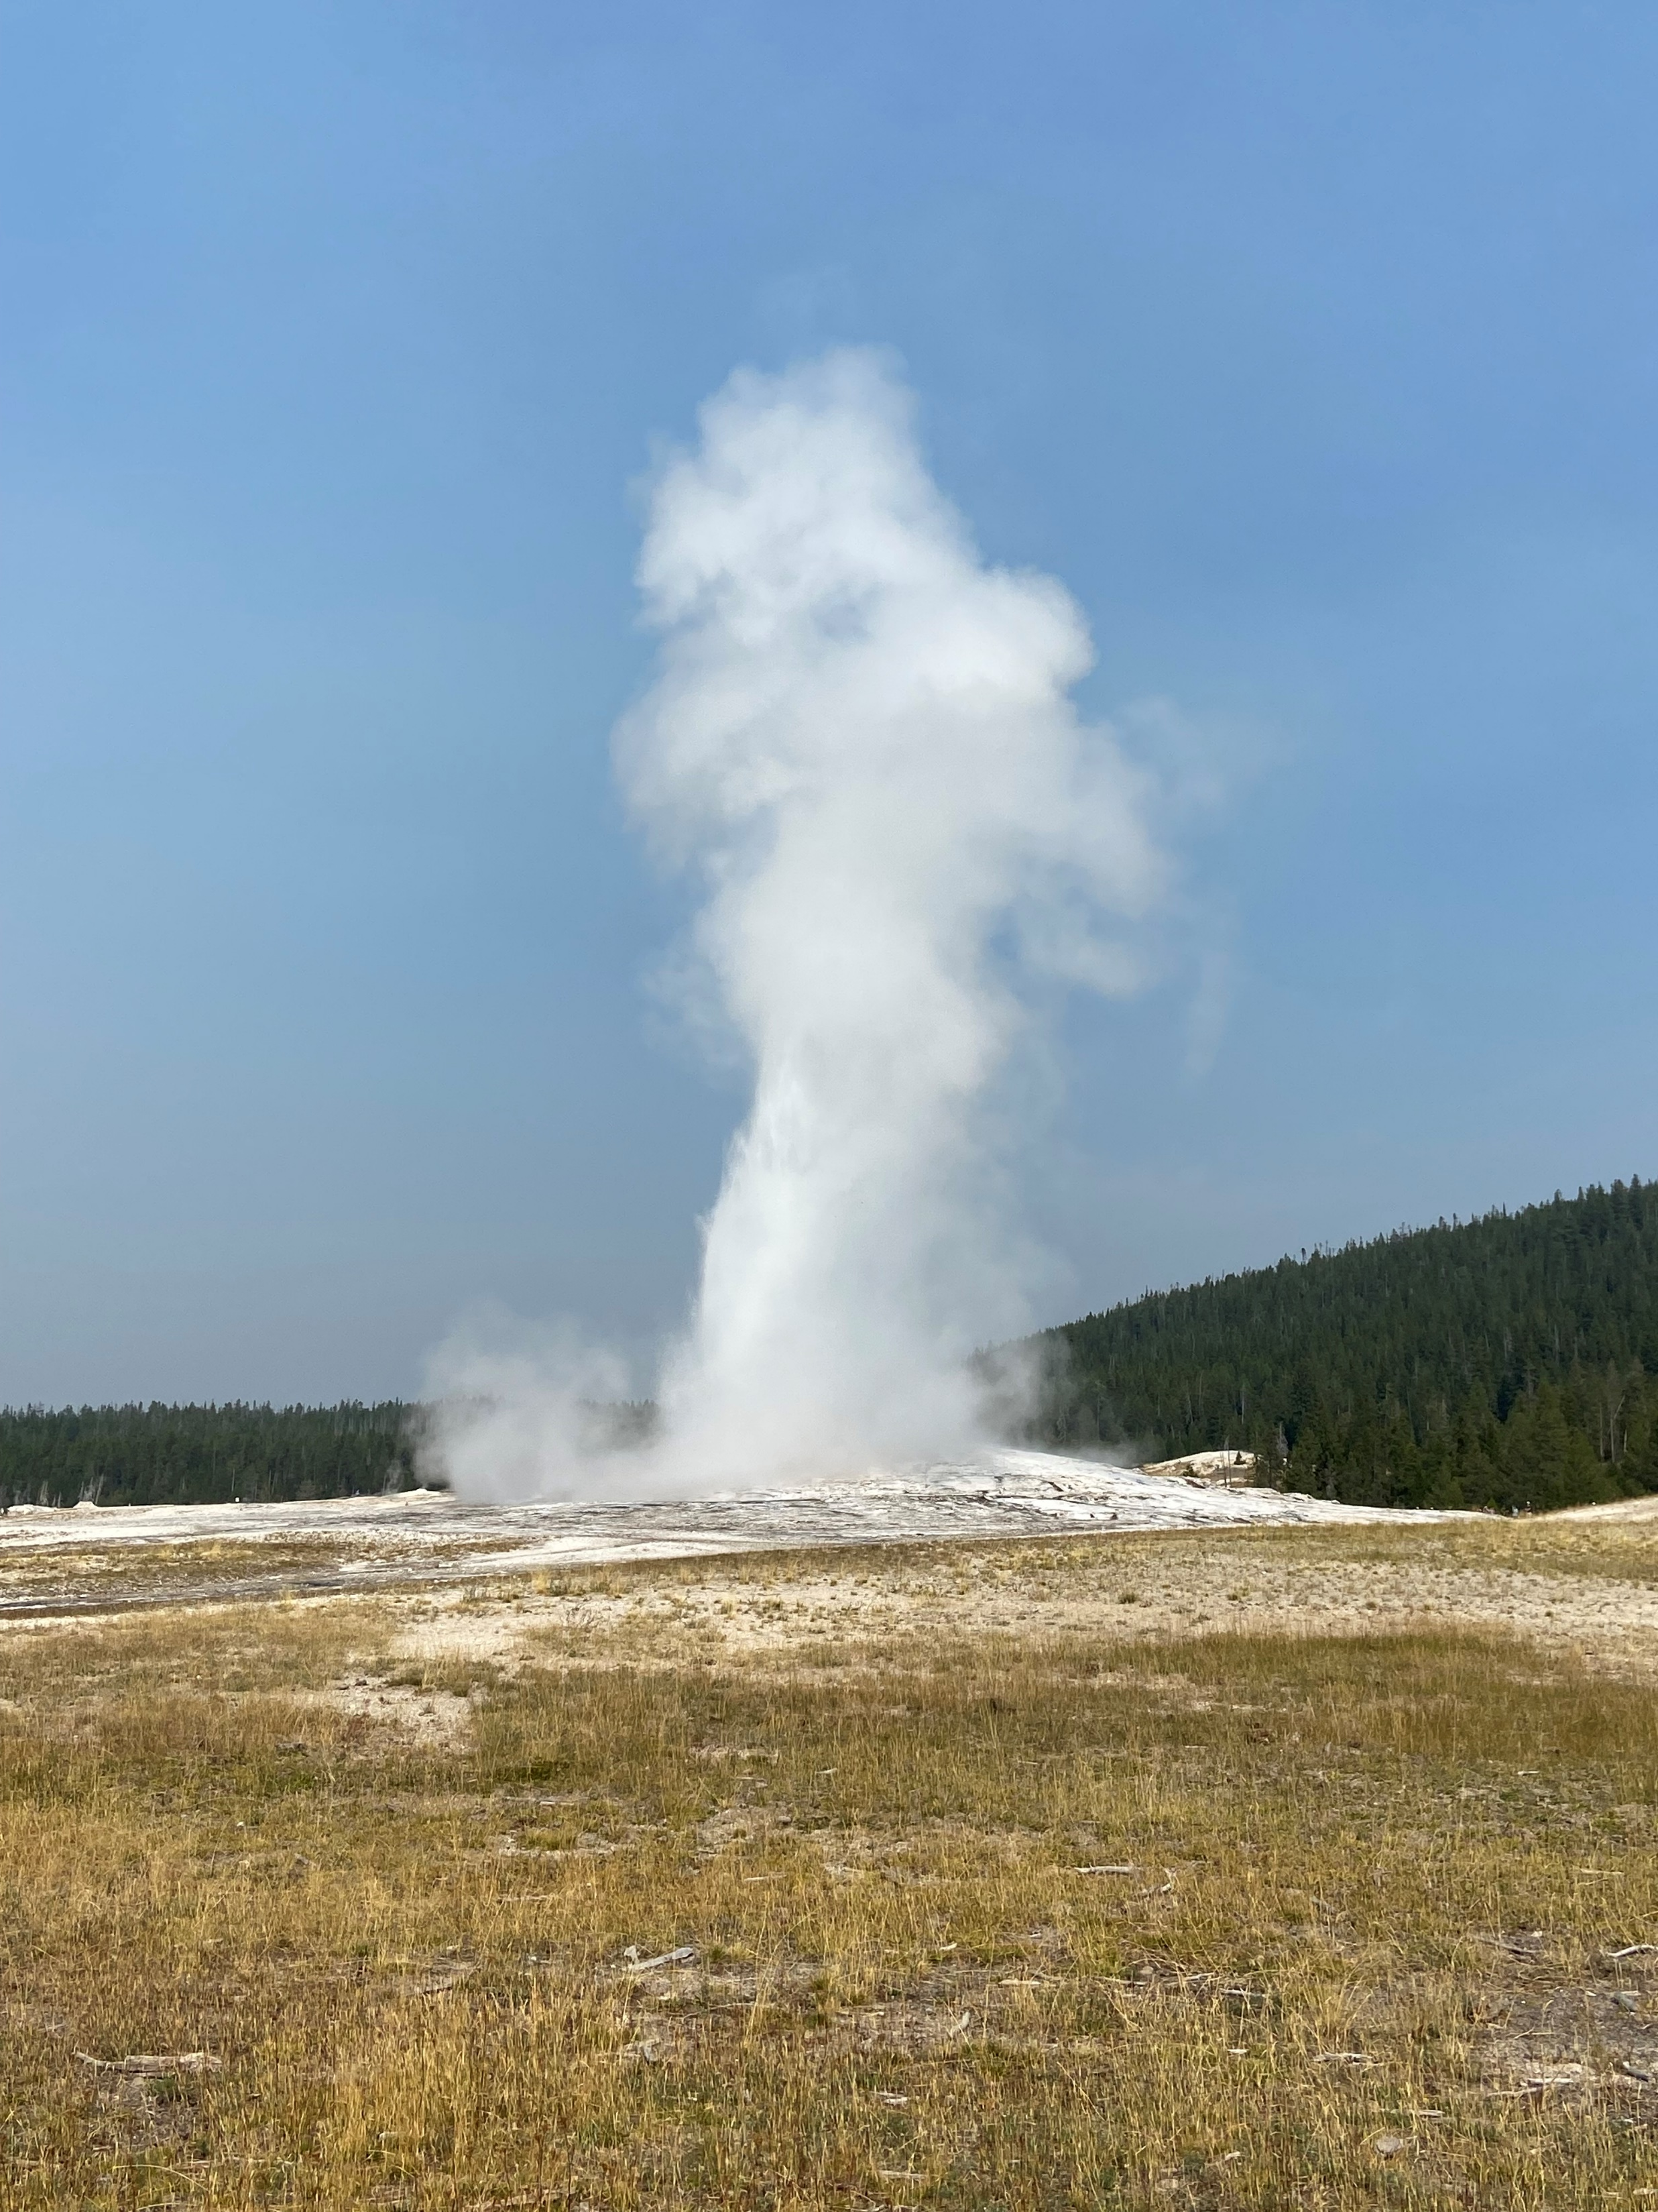
Objects https://github.com/InfoJunkie1/TempPerms
Schema
Two tables
Active table
Archive table
Four sprocs
Apply
Notify
Delete
Archive
Three jobs
Apply
Notify
Delete and archive

